Slide 1



IT@UofT: Leading change across the tri-campus community Strategic Plan (2019 – 2024)
Presented by Bo Wandschneider, Chief Information Officer, University of Toronto
May 3, 2019

Slide 2
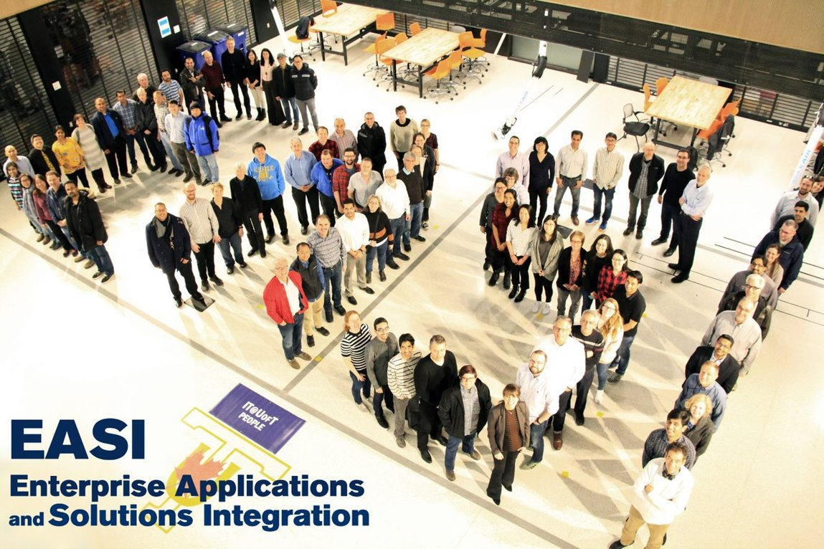
“ I would say, in a word, that the team I have is awesome! It is probably one of the most skilled and dedicated teams I’ve ever had at the University of Toronto.”
Cathy Eberts
Executive Director
Enterprise Applications and Solutions Integration
Information Technology Services

Slide 3
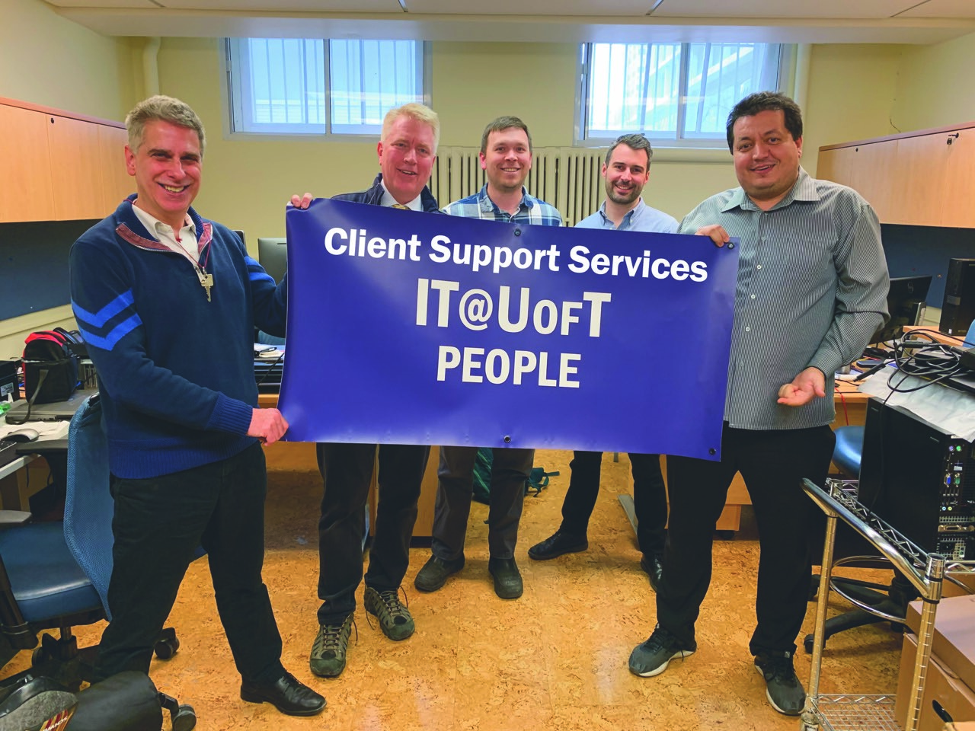
“This strategic planning exercise, in the breadth of its consulting, engagement, analysis and synthesis, has been a valuable process in understanding the role IT plays in the life of the University and its community.”
Marden Paul
Director
Planning, Governance and Assessment
Information Technology Services

Slide 4
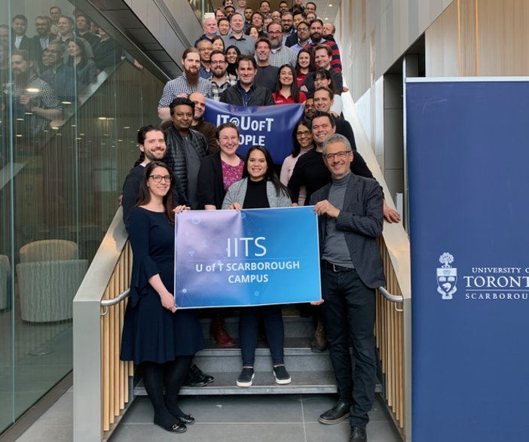
“It’s not really about just the immediate team you work with, it’s not even about the department you work in, in the end, we all play for team U of T.”
Zoran Piljevic
Director
Information and Instructional Technology Services
University of Toronto Scarborough

Slide 5
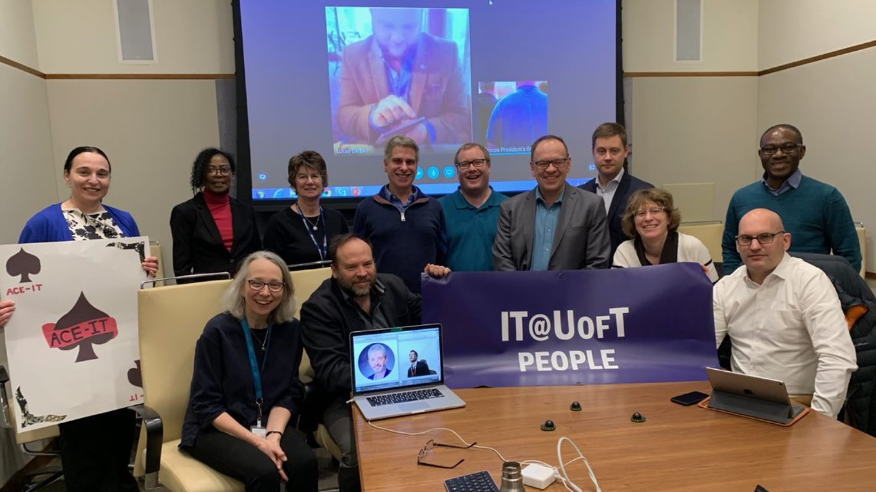
“If we’re more transparent, we can build trust and we can do a lot more than we can do individually. The sum of the whole is much more than the sum of the individual parts.”
Bo Wandschneider
Chief Information Officer
Information Technology Services

Slide 6
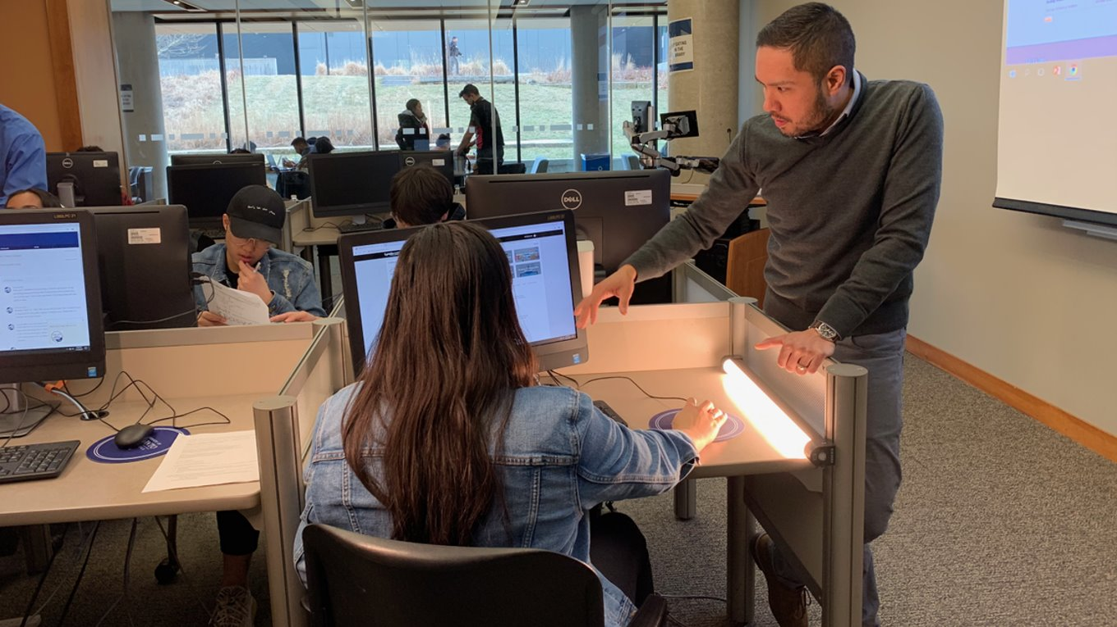

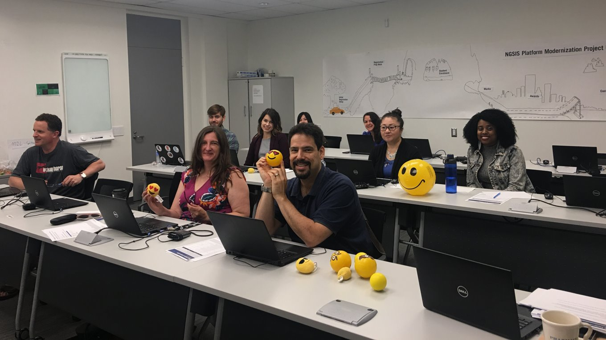
IT@UofT Framework
The IT@UofT Strategic Plan framework is inspired by a community-wide appetite for working collaboratively and collectively within a federated model based on a shared foundation and guiding principles.
The Strategic Plan is for the entire IT@UofT community.

Slide 7

IT@UofT Vision
IT@UofT provides leadership that enables the University to achieve our mission by fostering an integrated and collaborative community, built on creativity, agility, transparency and trust.​
Leadership
Integrated and collaborative community
Creativity
Agility
Transparency
Trust

Slide 8
IT@UofT Pillars
PEOPLE
SOLUTIONS
COLLABORATION

Slide 9

IT@UofT Guiding Principles
We take a University-wide view and embrace commonalities and strengths while respecting the diverse needs of the divisions and departments.
We strive to implement simple, sustainable and adaptable solutions for our community.
Security, privacy and accessibility are foundational to our work.
We trust and value peoples’ unique talents from across the University.
Through active engagement, the needs of the students, faculty and staff inform and shape our solutions.
We use technology deliberately to achieve efficiencies and deliver more effective service through digitalization and process transformation.

Slide 10
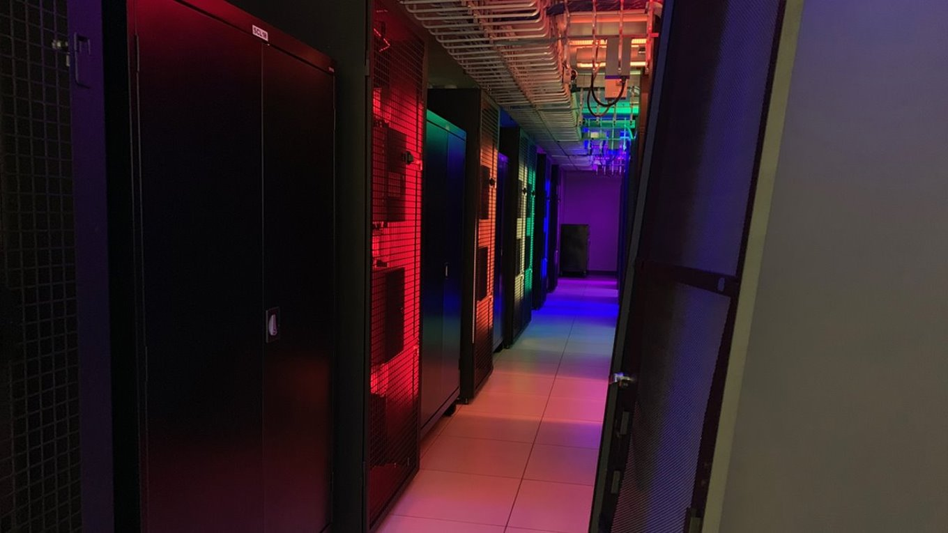
Benefits to U of T’s tri-campus community
Direction and a way forward
Build trust and transparency
Bolster priority setting, accountability and shared decision making

Slide 11



PEOPLE
Empower educators and learners through broader access to transformative teaching and learning apps and resources.
Digitalization of the University’s core administrative systems focused on process reengineering (including assessment, redesign and implementation of recommendations).
Create a culture of evidence-based (data driven) decision-making and information flow.
Enable a secure computing environment and protected management of information.
Leverage alternative service delivery models that can deliver enhanced security, increased agility, improved return on investment (ROI) and more flexible solutions.
Rationalize, standardize and simplify systems and services across the three campuses.
Example: Modernise and extend the Administrative Management Systems (AMS), including HR Talent Management Suite, Finance and Research systems
COLLABORATION
SOLUTIONS
Create a culture of continuous skill and professional development.
Cultivate high performance team practices in IT.
Increase the visibility, transparency and availability of IT talent and specialized skill sets.
Example: In partnership with HR, initiate an IT talent program for IT@UofT that embraces aspects such as recruitment, retention, diversity and secondments
Increase transparency and collaboration through proactive, streamlined and trust-based communication between ITS and the U of T community.
Improve collaboration and communication using distributed strategies to enable engagement across all units.
Leverage shared infrastructure and technologies supporting research.
Example: Facilitate efficiencies in project initiation and management through improved requirements gathering, intake processing, visibility and awareness of ITS projects across the University

Slide 12

Enough talking – let's hear from the most important pillar – IT@UofT People.

Slide 13


Slide 14
Thank you to the many people who helped make the IT@UofT Strategic Plan a success.

Slide 15
Many thanks to...
The steering committee:
Steve Bailey, Director, Academic + Campus Events
Donald Boyes, Associate Professor, Department of Geography and Planning
Judith Chadwick, Assistant Vice President, Research Services Office
Diane Horton, Associate Professor, Department of Computer Science
Ulrich J. Krull, Vice President and Principal, University of Toronto Mississauga
Meagan Lau, Graduate Student, iSchool
Mary Lyne, Chief Administrative Officer, Rotman School of Management
Susan McCahan, Vice Provost, Innovations in Undergraduate Education
Zoran Piljevic, Information and Instructional Technology Services Director, University of Toronto Scarborough
Jay Pratt, Vice Dean, Research and Infrastructure
Sean Suleman, Director of Human Resources and Workplace Investigations, HR & Equity
The Strategic Plan core team:
Marco Di Vittorio, Manager of Application Administration, Academic and Collaborative Technologies
Laurie Harrison, Director, Online Learning Strategies
Patrick Hopewell, Director, Enterprise Infrastructure Solutions
Carrie Schmidt, Senior Manager, Education and Awareness

Slide 16
Many thanks to...
The Education and Awareness team for communications strategy/planning, marketing, communications and media materials
Ann-Marie Colacino, Senior Communications Officer
Kathleen McLeod, Education and Awareness Officer
Selena Panchoo, Web Developer
Chloe Payne, Program Coordinator
Carrie Schmidt, Senior Manager
Meghan Kirwin, Facilitator
Academic + Campus Events
Intuitive Conference and Events
All ITS staff, managers and directors
The IT@UofT tri-campus community
The larger University of Toronto community
...and more. We couldn't have done it without you!

Slide 17


IT@UofT Next steps
Check out online for materials in the resource section of http://main.its.utoronto.ca/about/strategic-plan/
Look for communications and more info in the coming weeks and months
Contact info
cio@utoronto.ca Tel: 416-978-8385
@bjuul

Slide 18


Slide 19
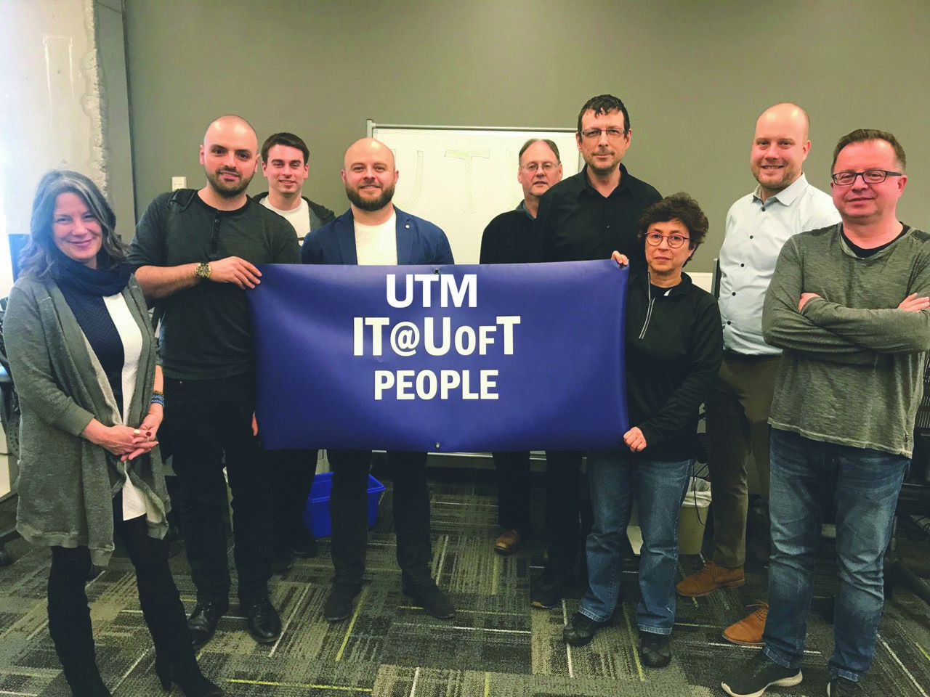
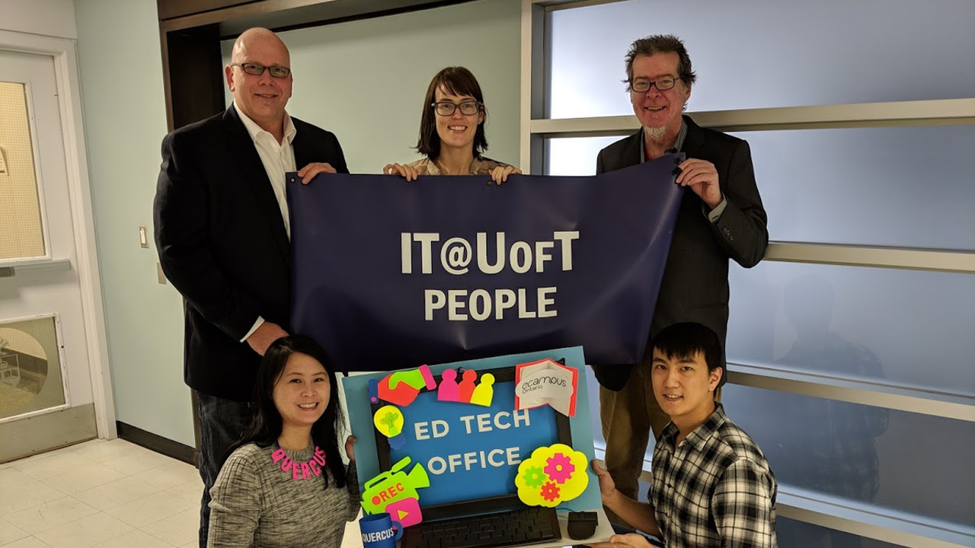
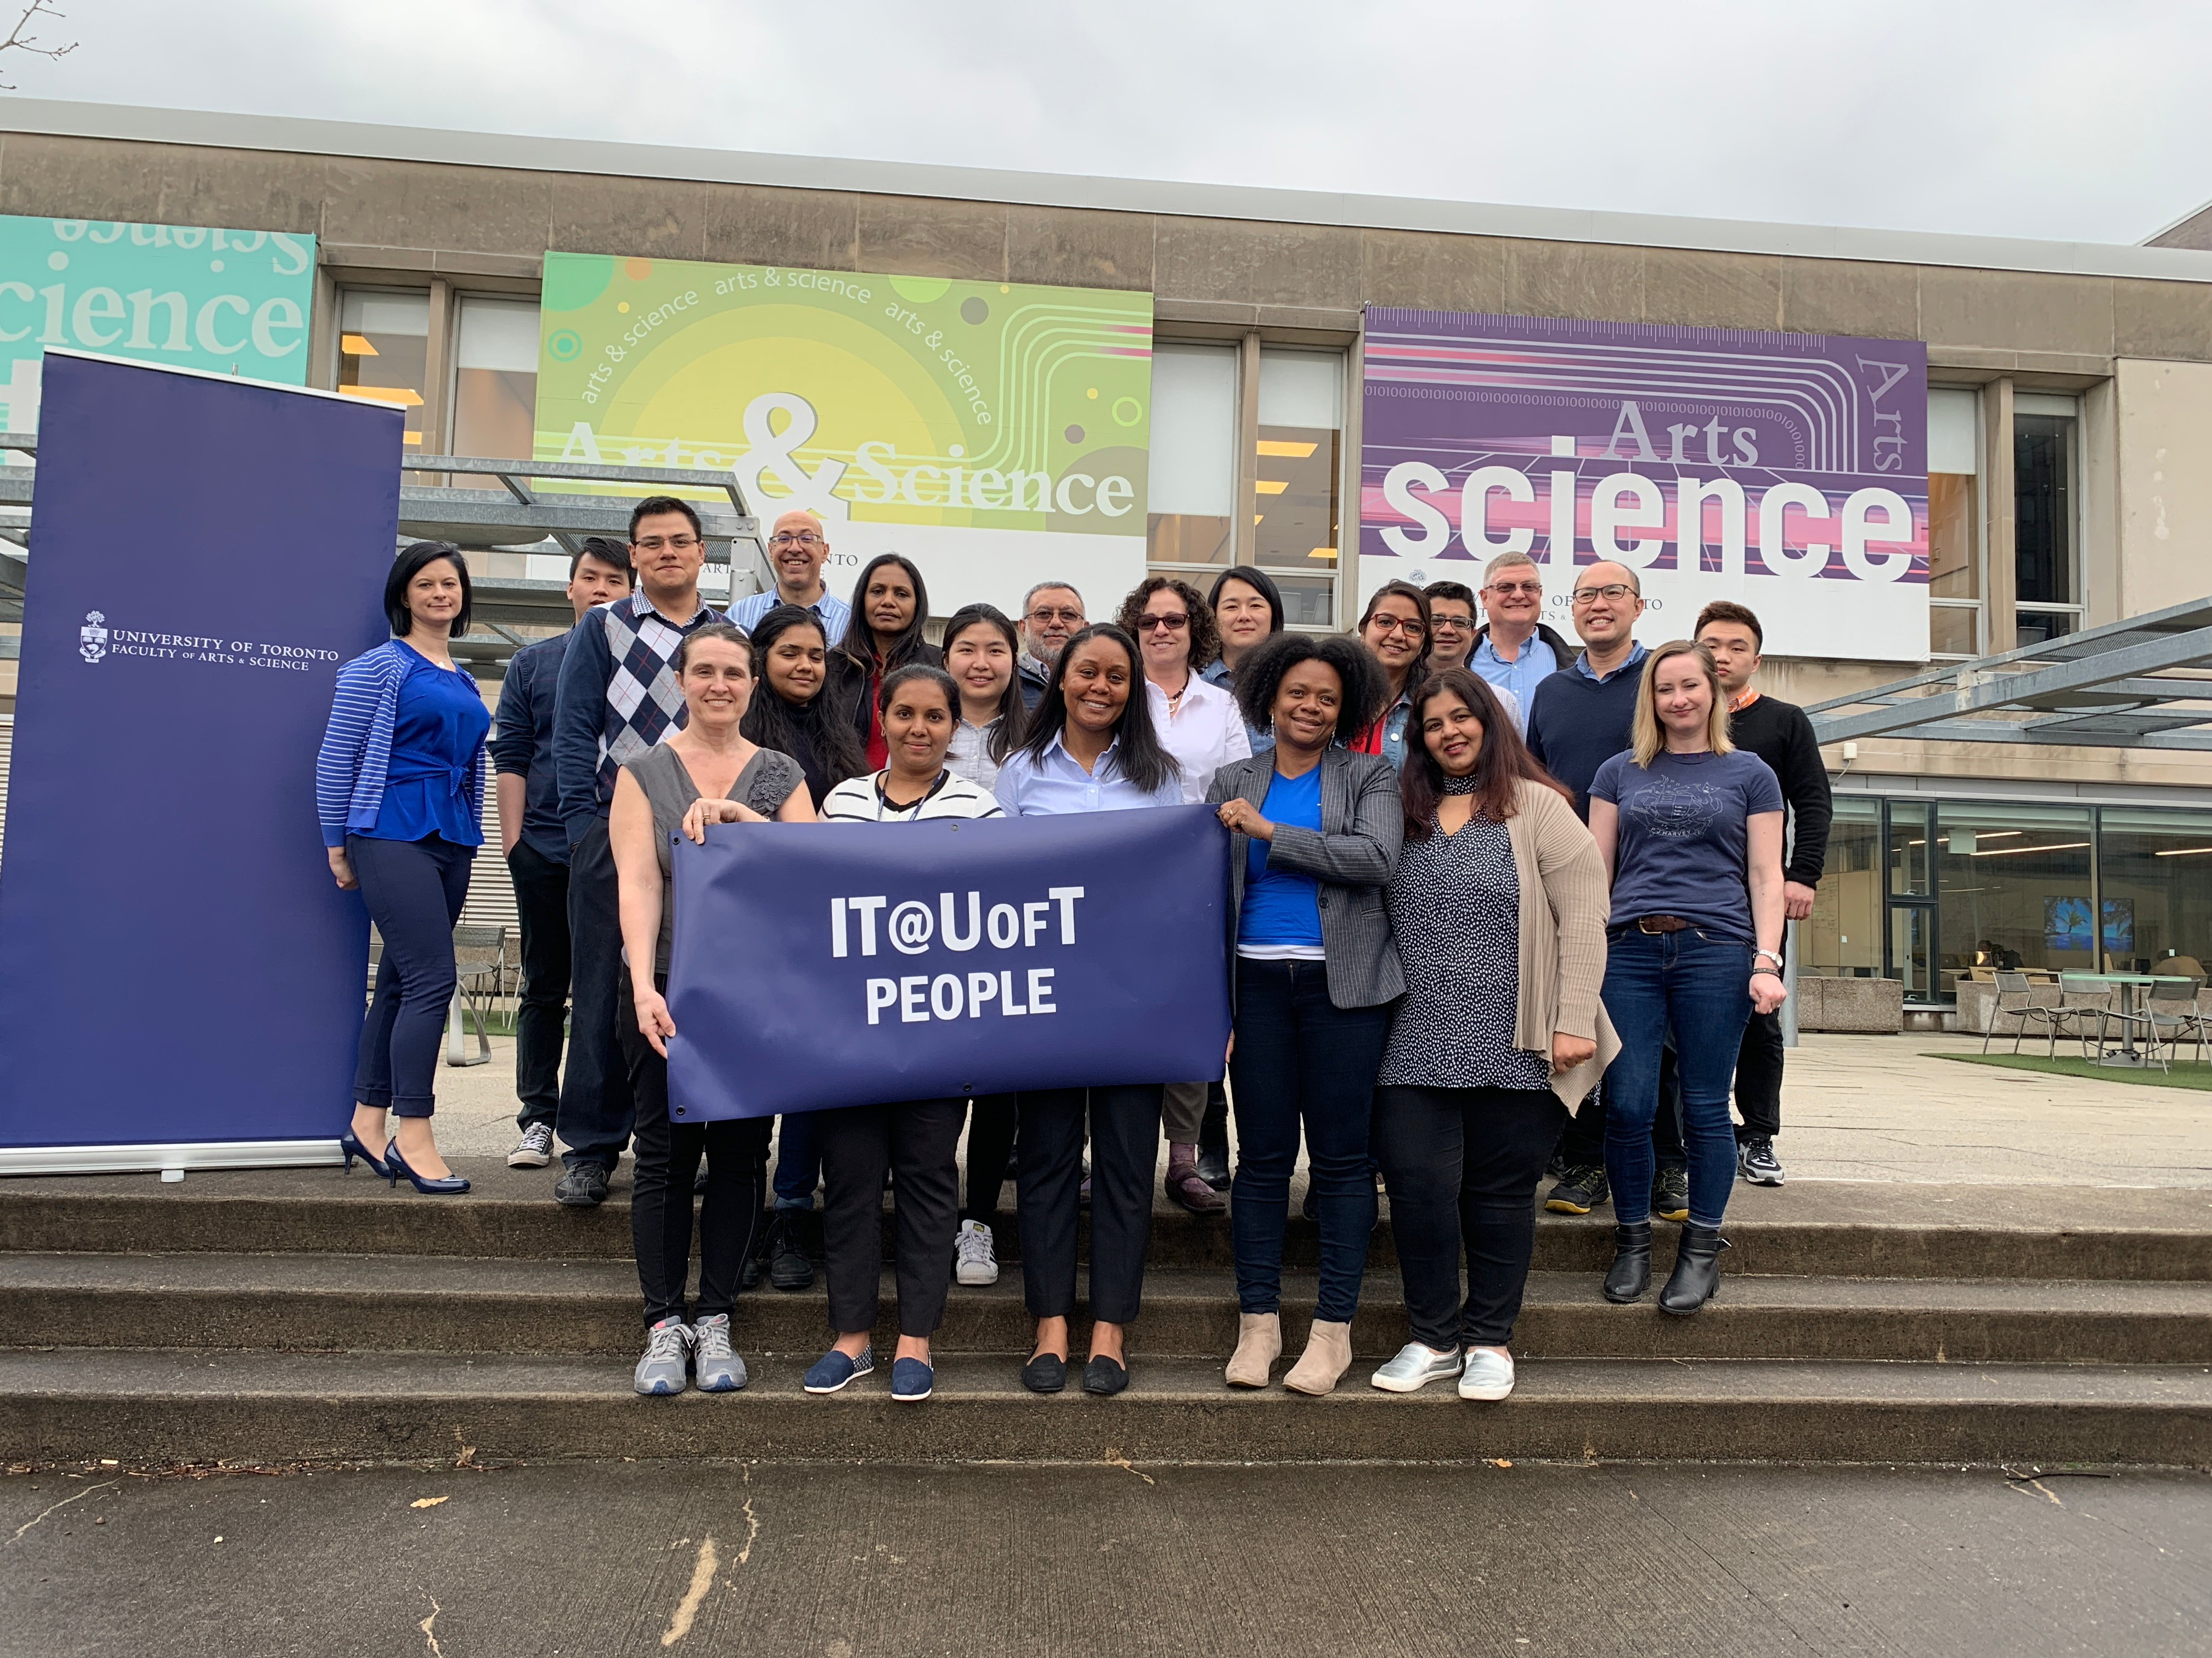
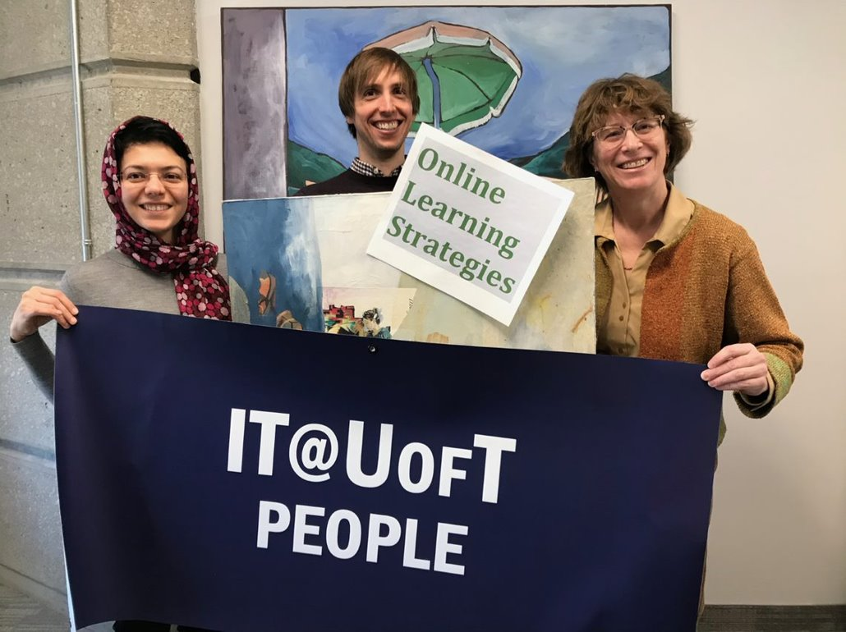
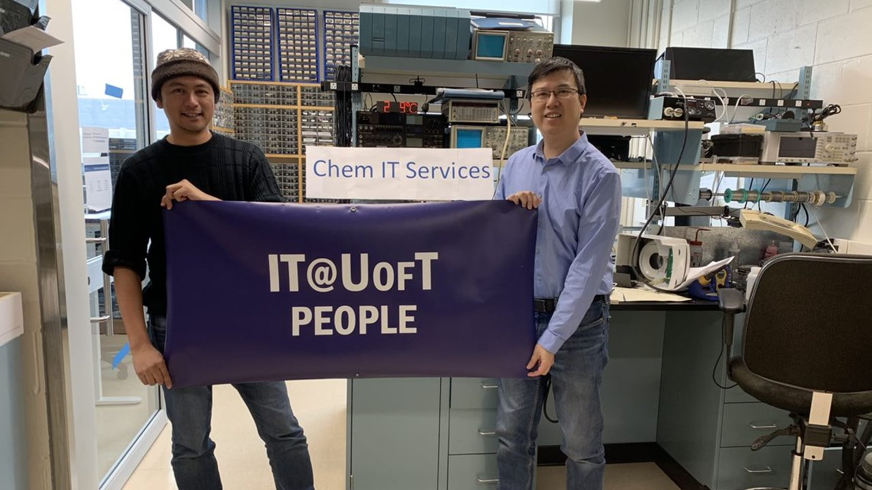

Slide 20
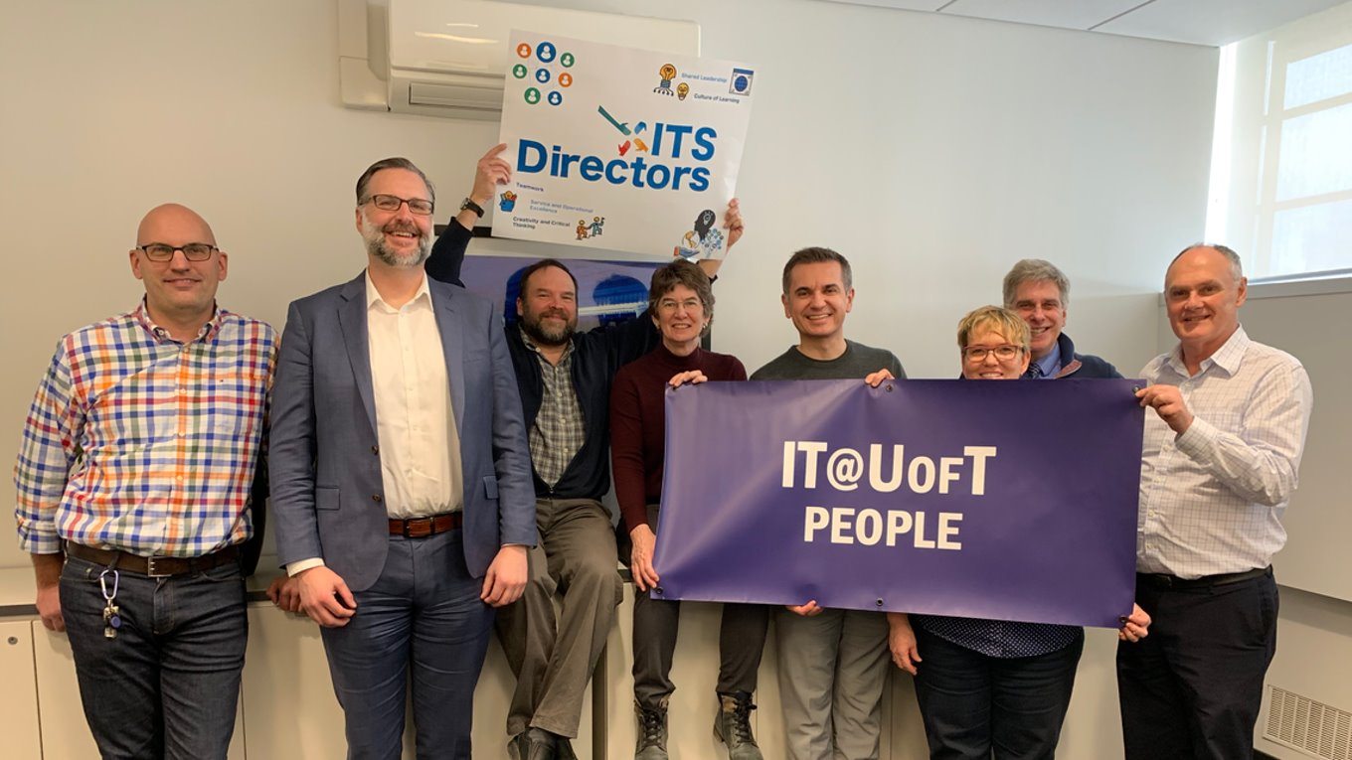
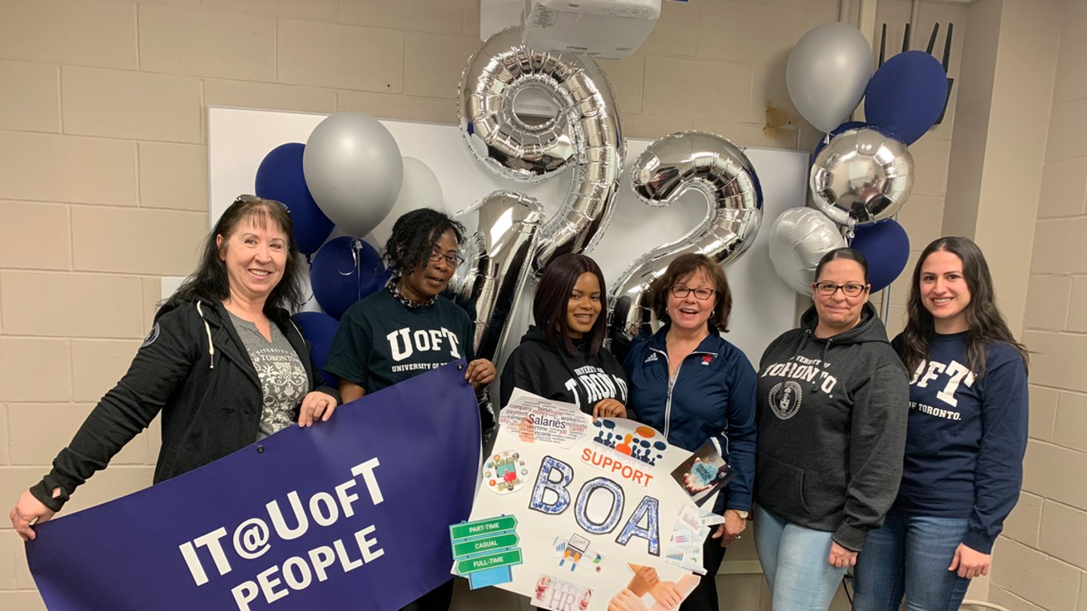
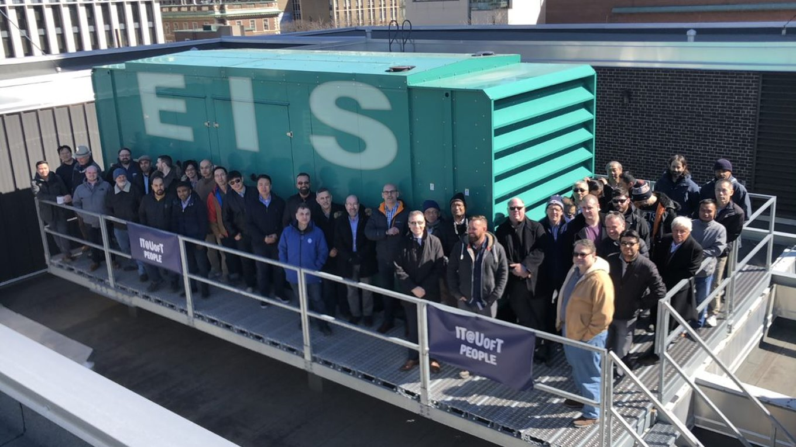
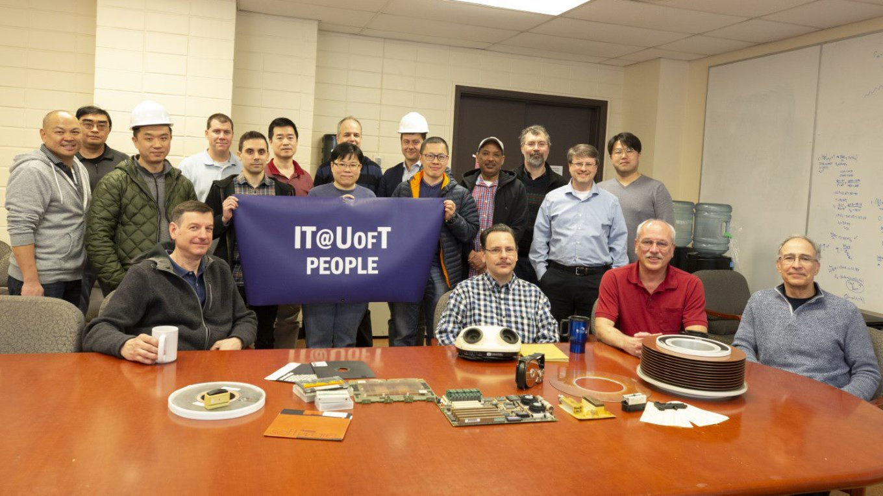
Last but not least, on your way out…
I encourage you to take some group pictures with the Strategic Plan signs in the foyer.
Don’t forget to pick up a treat at the table.
Grab handy materials – we have limited full reports, a comprehensive two-page summary and stickers for all.

